Slide 1
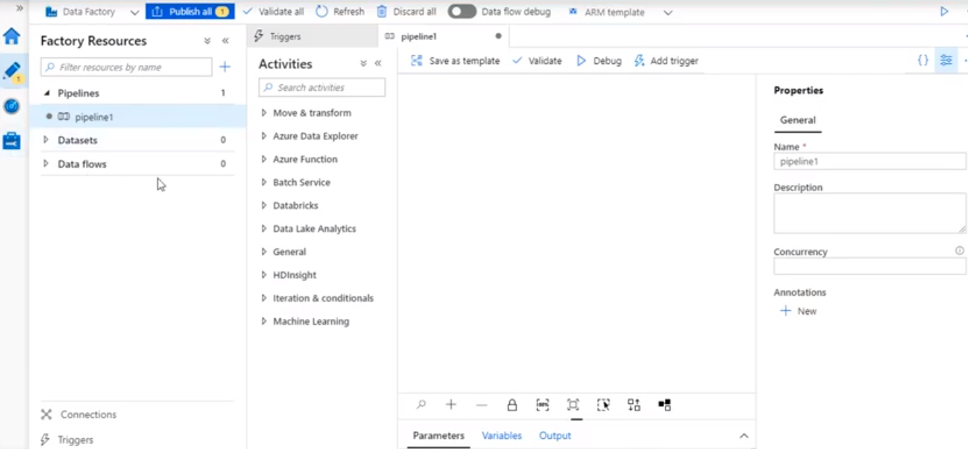

Slide 2



Slide 3
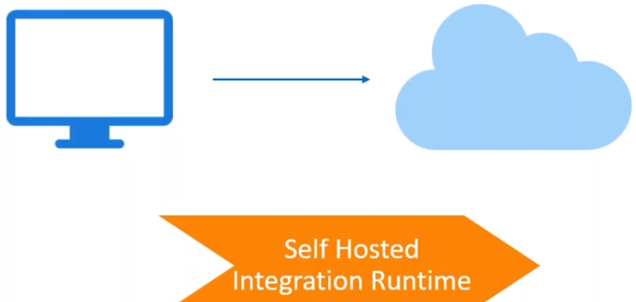
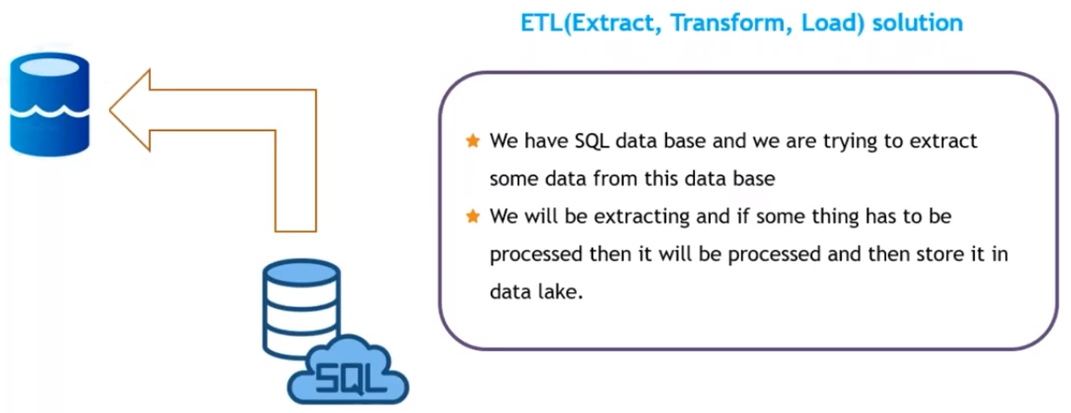
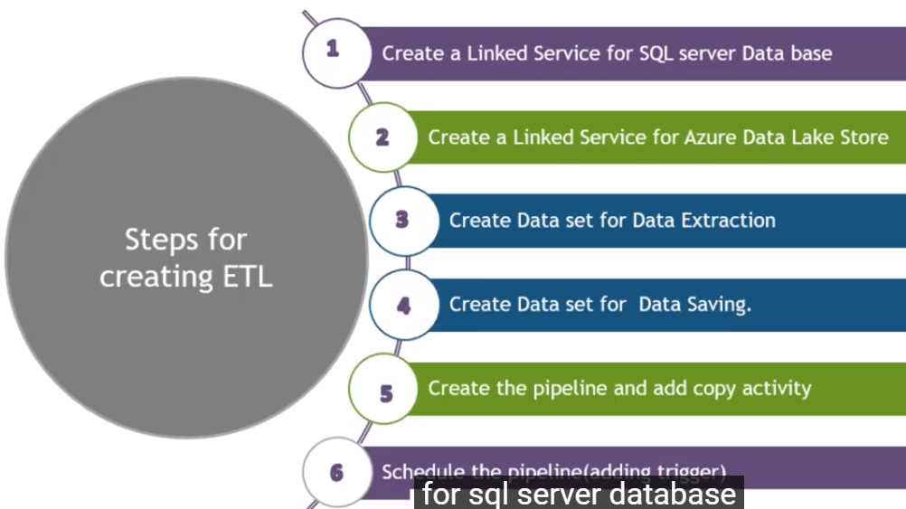

Slide 4
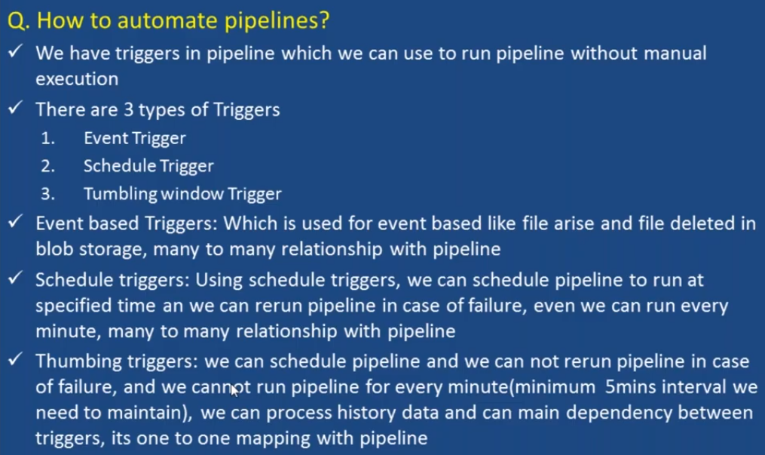

Slide 5
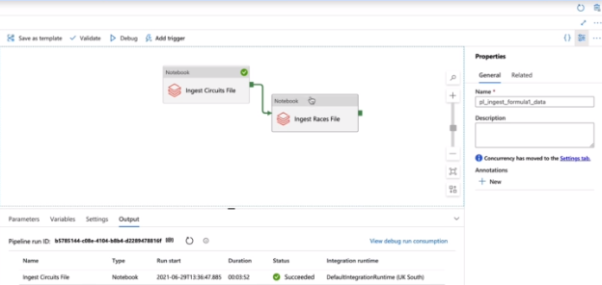
Am going to run races only when circuits successfully completed.

Slide 6
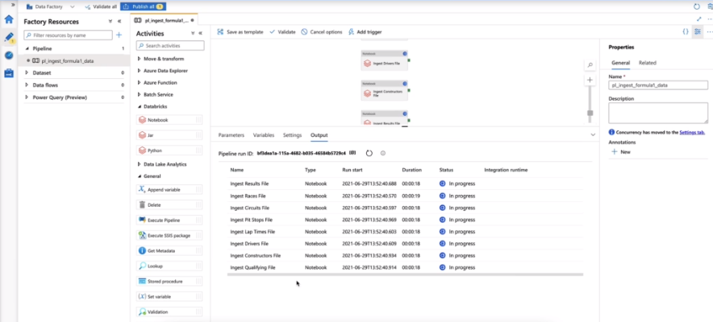
All of the notebooks along side each other on single cluster, can the cluster take workload?
In our case we have 8 notebooks but they are only small notebooks, so it can take workload.

Slide 7
